Slide 1
Data Structure & Algorithms
Session 04
Trees & Binary Search Trees

Slide 2
Objectives
Introduction to Trees
Application of Trees
Introduction to Binary trees
Introduction to Binary search trees (BST)
BST representation
Basic operations of BST:
Insertion
Searching
Deletion
Traversing

Slide 3
Introduction to Trees
A tree is a data structure that looks like this:
A tree consists of elements (temporarily called nodes of a tree) with a parent (or link) relationship, satisfying the following properties:
There is a special node called the root node (without the parent node).
The remaining nodes, each node has only one parent node.

Slide 4
Introduction to Trees
Example: folder tree
C:\
Documents and Settings
Program Files
My Music
Desktop
Favorites
Start Menu
Adobe
Microsoft Office

Slide 5
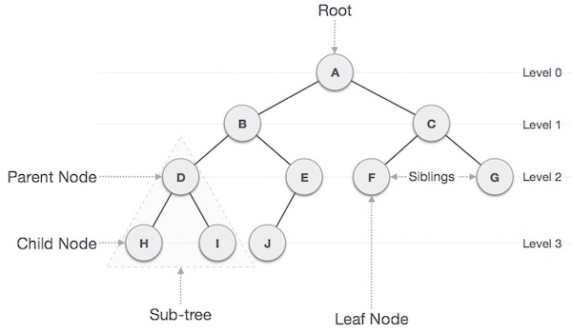
Important Terms of Trees

Slide 6
Important Terms of Trees
Some other important terms of trees to note:
Path − the sequence of nodes along the edges of a tree.
Visiting − checking the value of a node when control is on the node.
Traversing − passing through nodes in a specific order.
Keys − represents a value of a node.
Notes:
There are many types of tree structures, We will discuss binary tree or binary search tree specifically.

Slide 7
Applications of Trees
Trees and their variants are an extremely useful data structure with lots of practical applications:
Binary Search Tree is used to quickly check whether an element is present in a set or not.
Heap is a kind of tree that is used for heap sort.
Most popular databases use B-Trees and T-Trees
Compilers use a syntax tree to validate the syntax of every program you write.
…

Slide 8
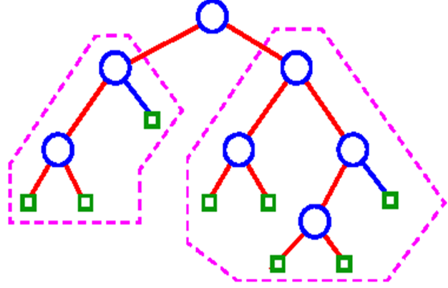
Introduction to Binary trees
A binary Tree is a special type of generic tree in which, each node can have at most two children.
When a
binary tree has
two children
each node
is called a
full binary tree.

Slide 9
Introduction to Binary Search Trees
A common type of binary tree is a binary search tree, in which every node has a value that is:
greater than or equal to the node values in the left sub-tree
less than or equal to the node values in the right sub-tree.
A BST is used to quickly check whether an element is present in a set or not, with time complexity of log₂(n) (n is number node of BTS).

Slide 10
Introduction to Binary Search Trees
Example
44
18
88
13
37
59
108
15
23
40
55
71

Slide 11
BST representation
In java, BST can be represented as follows:
public class BinarySearchTree {
class Node {
int Key;
Node left;
Node right;
// define operations here
}
Node root;
// define operations here
}

Slide 12
Basic operations of BST
Insert − Inserts an element in a tree/create a tree.
Search − Searches an element in a tree.
Delete − delete an element in a
Traverse: traverses the tree, there are 3 ways to traverse
Pre-order Traversal (NLR – node left right)
In-order Traversal (LNR – left node right)
Post-order Traversal (LRN – left right node)

Slide 13
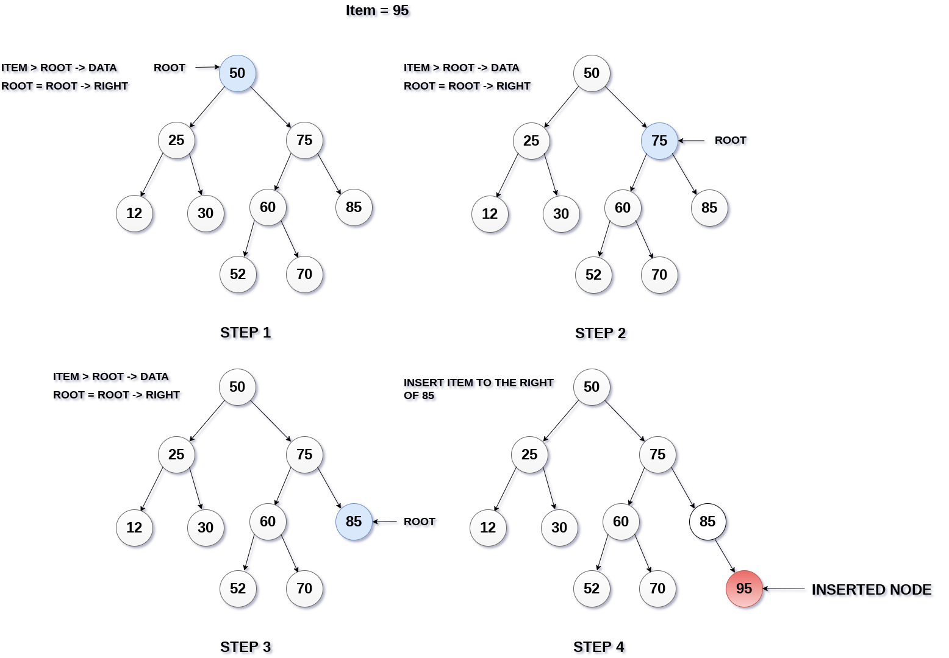
Insert operation

Slide 14
Insert operation
Node Insert (ROOT, ITEM)
Step 1:
IF ROOT = NULL
New P
ROOT = P
ELSE Go to step 2
Step 2:
IF ITEM < ROOT -> Key Insert(ROOT -> LEFT, ITEM)
ELSE Insert(ROOT -> RIGHT, ITEM)
[END OF IF]
Step 3: END

Slide 15
Insert operation
Node insertRec (Node root, int key) {
/* If the tree is empty, return a new node */
if (root == null) {
root = new Node(key);
return root;
}
/* Otherwise, recur down the tree */
if (key < root.key)
root.left = insertRec(root.left, key);
else if (key > root.key)
root.right = insertRec(root.right, key);
/* return the (unchanged) node pointer */
return root;
}

Slide 16
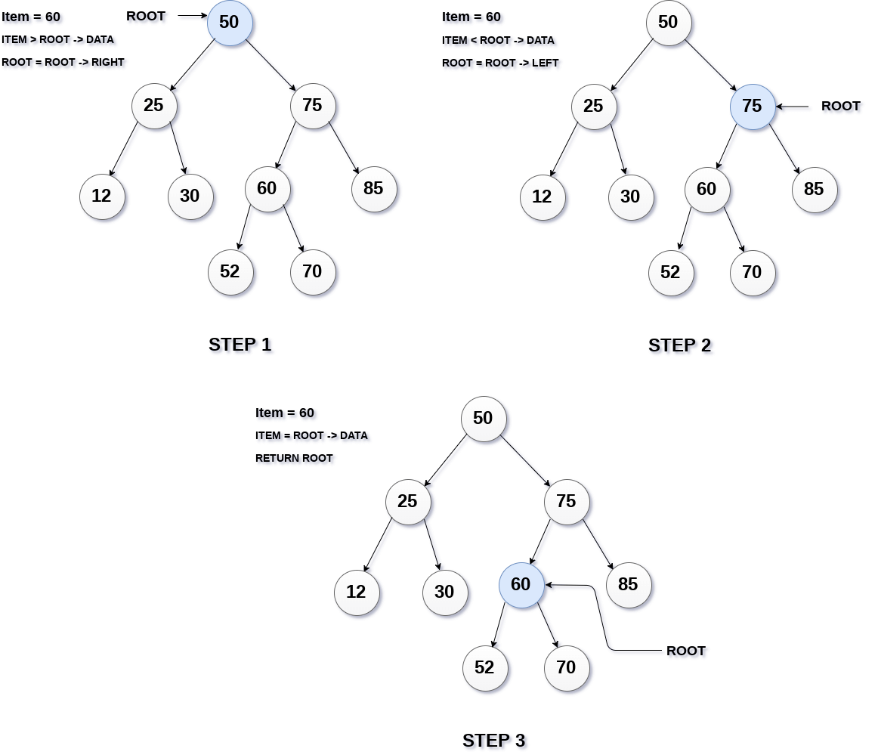
Search operation

Slide 17
Search operation
Node Search (ROOT, ITEM)
Step 1:
IF ROOT -> Key = ITEM OR ROOT = NULL
Return ROOT
ELSE go to Step 2
Step 2:
IF ROOT < ROOT -> Key
Return search(ROOT -> LEFT, ITEM)
ELSE
Return search(ROOT -> RIGHT,ITEM)
[END OF IF]
Step 3: END

Slide 18
Search operation
public Node search(Node root, int key)
{
//root is null or key is present at root
if (root==null || root.key==key)
return root;
// val is greater than root's key
if (root.key > key)
return search(root.left, key);
// val is less than root's key
return search(root.right, key);
}

Slide 19
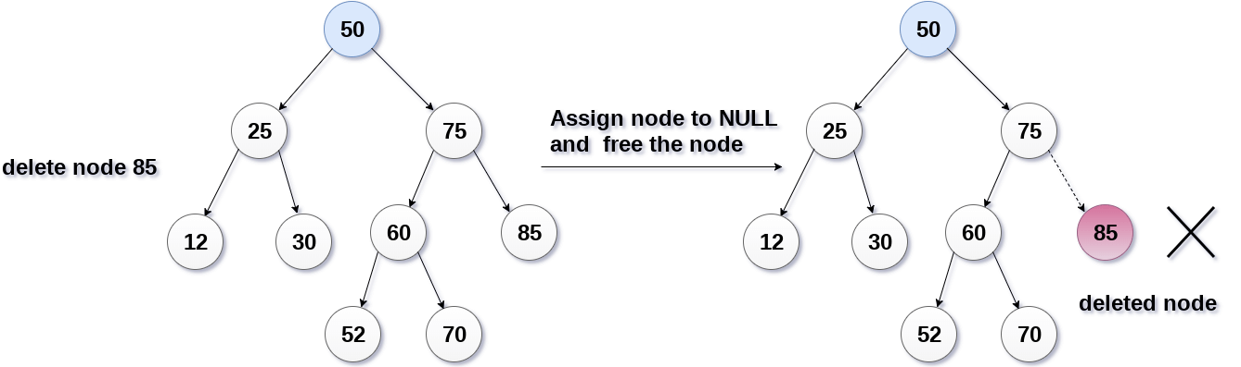
Delete operation
There are three situations of deleting a node from binary search tree.
The node to be deleted is a leaf node. In this case, replace the leaf node with the NULL

Slide 20
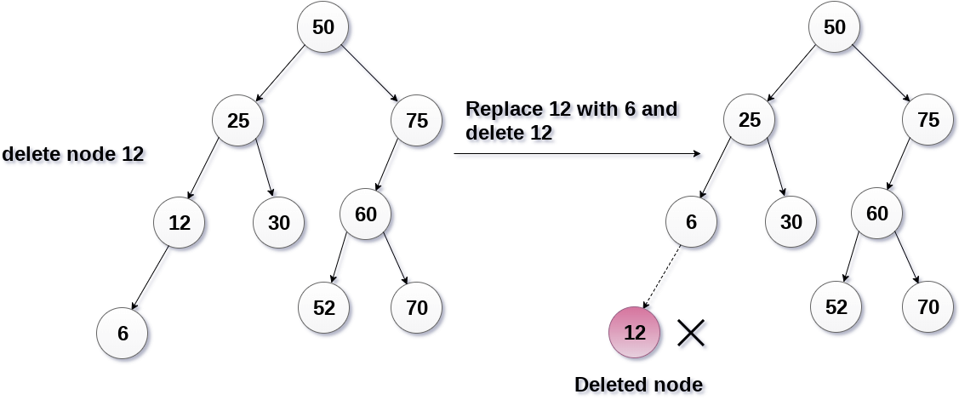
Delete operation
The node to be deleted has only one child. In this case, replace the node with its child and delete the child node.

Slide 21
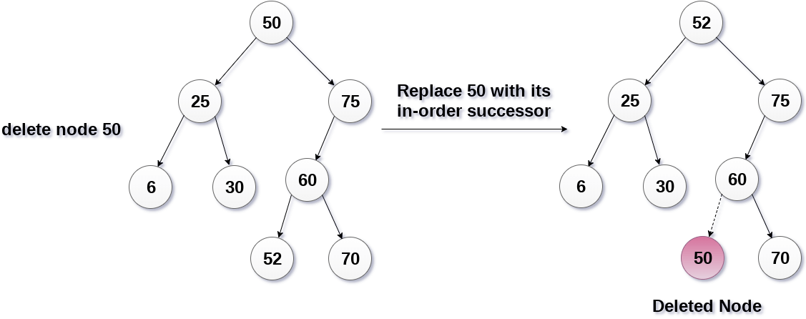
Delete operation
The node D to be deleted has two children. In this case, we find the replacement node R, replace D by R and then delete R, which has 2 suitable locations:
the maximum value in left child of the node
the minimum value in right child of the node

Slide 22
Delete operation
Delete (TREE, ITEM)
Step 1:
IF TREE = NULL
Write "item not found in the tree" and END
[END OF IF]
Step 2:
IF ITEM < TREE -> Key
Delete(TREE->LEFT, ITEM)
ELSE IF ITEM > TREE -> Key
Delete(TREE -> RIGHT, ITEM)
ELSE IF TREE -> LEFT != NULL AND TREE -> RIGHT != NULL
SET TREE->Key = findLargestValue(TREE -> LEFT) //Or find Min value of TREE - RIGHT
Delete(TREE -> LEFT, TEMP -> Key) //if find min then Delete(TREE -> RIGHT, TEMP -> Key)
ELSE IF TREE -> LEFT = NULL AND TREE -> RIGHT = NULL
SET TREE = NULL
ELSE IF TREE -> LEFT != NULL
SET TREE = TREE -> LEFT
ELSE
SET TREE = TREE -> RIGHT
END OF IF
Step 3: END

Slide 23
Delete operation
Node deleteRec(Node root, int key)
{
/* Base Case: If the tree is empty */
if (root == null) return root;
/* Otherwise, recur down the tree */
if (key < root.key)
root.left = deleteRec(root.left, key);
else if (key > root.key)
root.right = deleteRec(root.right, key);
===>

Slide 24
Delete operation
// if key is same as root's key, then This is the node to be deleted
else// node with only one child or no child
{
if (root.left == null)
return root.right;
else if (root.right == null)
return root.left;
// node with two children: find smallest in the right subtree)
root.key = minValue(root.right);
// Delete the replacement node
root.right = deleteRec(root.right, root.key);
}
return root;
}

Slide 25
Delete operation
int minValue(Node root)
{
int minv = root.key;
while (root.left != null)
{
minv = root.left.key;
root = root.left;
}
return minv;
}

Slide 26
Traverse operation
Pre-order Traversal (NLR – node left right)
A
B
C
D
E
F
G
H
I
J
K
L
M
N
O
P
Result:
A
B
D
H
I
N
E
J
O
K
C
F
L
P
G
M

Slide 27
Traverse operation
Pre-order Traversal (NLR – node left right)
void NLR(Node Root)
{
if (Root != NULL)
{
traverse Root.Key;
NLR(Root.left);
NLR(Root.right);
}
}

Slide 28
Traverse operation
In-order Traversal (LNR – left node right)
A
B
C
D
E
F
G
H
I
J
K
L
M
N
O
P
Result:
H
D
N
I
B
J
O
E
K
A
F
P
L
C
M
G

Slide 29
Traverse operation
In-order Traversal (LNR – left node right)
void LNR(Node Root)
{
if (Root != NULL)
{
LNR(Root.left);
traverse Root.Key;
LNR(Root.right);
}
}

Slide 30
Traverse operation
Post-order Traversal (LRN – left right node)
A
B
C
D
E
F
G
H
I
J
K
L
M
N
O
P
Result:
H
N
I
D
O
J
K
E
B
P
L
F
M
G
C
A

Slide 31
Traverse operation
Post-order Traversal (LRN – left right node)
void LRN(Node Root)
{
if (Root != NULL)
{
LRN(Root.left);
LRN(Root.right);
traverse Root.Key
}
}

Slide 32
Summary
A tree consists of nodes with a link relationship, there is a special node called the root node (without the parent node) and the remaining nodes, each node has only one parent node
A binary Tree is a special type of generic tree in which, each node can have at most two children, they are called the left and the right child.
Binary search trees (BTS) sometimes called a sorted binary trees, they are used to quickly check whether an element is present in their with time complexity of log₂(n) (n is number node of BTS).

Slide 33
References
https://www.tutorialspoint.com/data_structures_algorithms/tree_data_structure.htm
https://www.programiz.com/dsa/trees
https://www.javatpoint.com/binary-tree
https://www.geeksforgeeks.org/binary-search-tree-set-1-search-and-insertion/
https://www.geeksforgeeks.org/binary-search-tree-set-2-delete/

Slide 34


